Slide 1
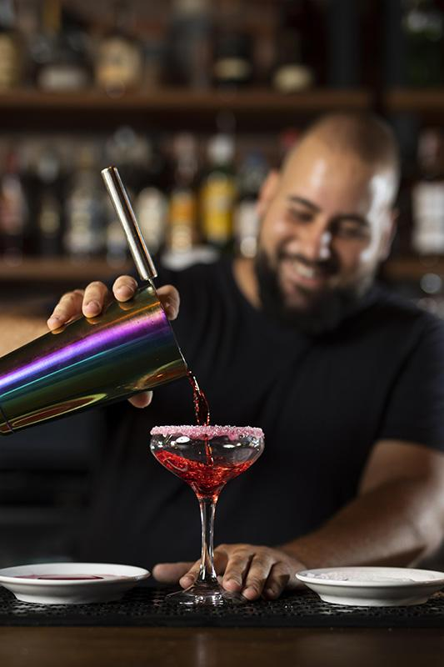
Total Wine
Tequila Product Assortment
The Brains Behind the Barrel
Donovan Downie | Joanna Kwok | Sameera Jampala
Srishti Gupta | Tarunika Gurram | Valerie Markel
Notes:
Srishti

Slide 2

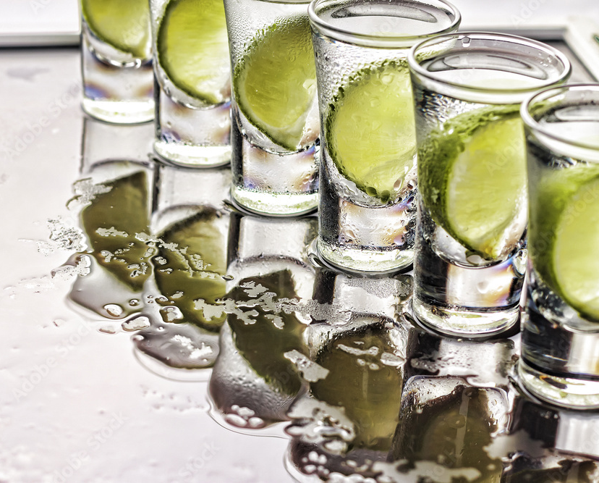
From Shots to Sophistication
Tequila has evolved from party shots and margaritas to a premium experience.
Sipping, savoring, and celebrating like never before.
Welcome to the tequila revolution
Notes:
Srishti
simple party drink to a sophisticated spirit used in various cocktails.

Slide 3
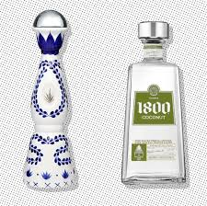
7.1%
Tequila Growth
US AVERAGE YEARLY GROWTH SINCE 2003
While value and premium brands continue to grow, the fastest growth has been in high-end and super premium brands.
Notes:
Srishti “Tequila is one of the fastest-growing spirits globally, and experts anticipate this growth to continue into the next decade. In fact, according to IWSR, tequila recently overtook whiskey to become the second most valuable spirit in the United States, and it is set to surpass vodka by the end of 2023.”
"Did you know that tequila sales in the U.S. grew by over 7% last year, making it one of the fastest-growing spirits categories? This explosive growth presents a unique opportunity for Total Wine to optimize its tequila assortment and better meet customer demand."
Closing hook: Remember that surprising growth in tequila sales we mentioned at the start? With the insights from our project, Total Wine can turn that growth into lasting success by aligning its tequila offerings with customer needs and trends As tequila continues to captivate U.S. consumers, Total Wine has the opportunity to lead the way with smarter, data-driven product assortments.

Slide 4







Meet the Team
Srishti Gupta
Joanna Kwok
Sameera Jampala
Valerie Markel
Donovan Downie
Tarunika Gurram
Notes:
Srishti

Slide 5

00
Executive Summary

Slide 6
Executive Summary
The Problem :
How can Total Wine optimize tequila assortments to align with local preferences, reduce inefficiencies, and boost sales?
Our Approach :
Integrated diverse datasets: internal sales, demographics and Google Search trends.
Built predictive model with CatBoost algorithm with tuned hyperparameters.
Validated model with test set and made predictions on held-out data.
Baseline Error: 7246.99
Average Final Error : 2913.9
MAE : 1409.43
RMSE : 4417.7
Notes:
Tarunika
This is what we need to do, this is what we did, this is what we saw

Slide 7
Agenda
01
Business Problem & Objectives
02
Data Considerations
03
Exploratory Data Analysis
04
Model Description and Metrics
05
Insights and Recommendations
Notes:
Tarunika

Slide 8
01
Business Problem & Objectives

Slide 9
Business Problem
How can Total Wine leverage tequila’s unique cultural significance, regional production, and distinct flavor profiles to optimize product assortment & demand forecasting, aligning with local preferences to reduce inventory inefficiencies & maximize revenue?
Stakeholders include…..
Total Wine
Tequila Suppliers
Customers
1
2
3
Notes:
Tarunika

Slide 10
Project Objectives
Predictive Model
Store Assortment Recommendation
One Specific Tequila Assortment
Use historical tequila sales data, store-level attributes, tequila trends, & surrounding demographic information.
Pick a specific store & determine its best tequila product assortment.
Pick an underrated tequila & forecast its demand in each store.
Notes:
Tarunika

Slide 11
02
Data Considerations

Slide 12
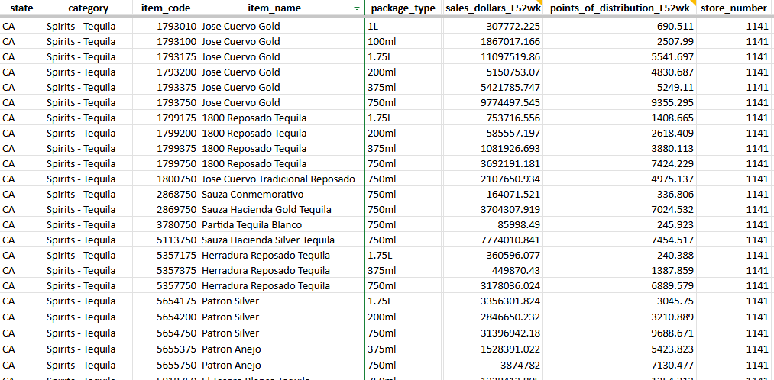
Data Source
Primary source of data: TW internal, external demographics, & other stores total sales
Data Volume Summary
Tequila (Internal Sales)
94423 rows
1914 unique item codes
Tequila (External Data)
18733 rows
8 columns.
Store Information
269 rows
35 columns.
Merged on Item Code and State
94423 rows
30 variables.
Notes:
slide 2 Tarunika
2. Data Source
• Primary source of data; supplemental data; simulated data, if any
• Unavailable/Unshared data & data contentions
• Data volume summary (rows, columns, size etc)
Primary source of data(what data was given to us)—> say if there’s a smaller data set we are deal with
Supplemental data-ex: trends of tequila in the US
Simulated data- construct data to see what the system would do ex(real profits that total wines make but they won’t share that with us)
Data contentions- won’t share data from other organizations
Tarunika

Slide 13
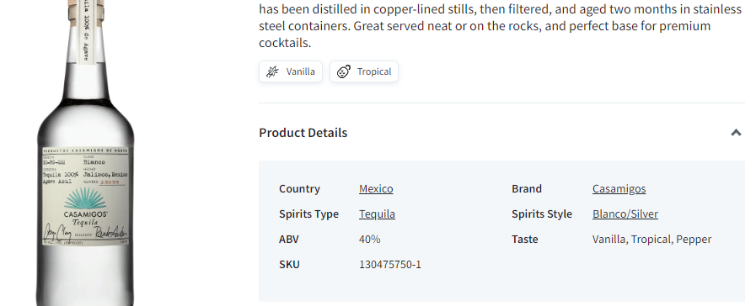
Data Highlights
Additional Data Sources
Scraped Spirits Style of tequila products from the Total Wine website
Categorize: Blanco/Silver, Reposado, Anejo, Mezcal, Cristalino, Gold, Other
Google search trends:
“Tequila”, “Cheap tequila” , “Best Tequila”. “Reposado tequila”, “Anejo tequila”, “Silver tequila”
Celebrity brand tequila: is categorized as a binary variable—either 1 for celebrity-owned brands or 0 for others.
Notes:
Sameera
Tequila category: based on aging: Blanco (unaged or lightly aged), Reposado (2-12 months), Añejo (1-3 years).
No data on Losses & Costs for Maintaining Tequila Brands:
What to do with it: Calculate profit margins for each tequila brand, dentify underperforming or costly brands that contribute less to overall profitability. Use this data to refine your assortment strategy & ensure only high-margin brands are prioritized.
No Information on Holiday Sales Fluctuations for Tequila:
What to do with it: Analyze historical holiday sales data to identify patterns & spikes in demand. Create seasonal forecasting models to optimize inventory levels & pricing strategies for peak periods. This could lead to better promotion planning & stocking decisions.

Slide 14
Data Highlights
Unavailable Data
Seasonal Data
Losses & Costs
Other Age Demographics
What to do with it: Analyze holiday sales to forecast demand & optimize inventory, pricing, & promotions for peak periods.
What to do with it: Calculate profit margins, identify underperforming brands, & prioritize high-margin options to refine the assortment strategy.
What to do with it: Compare different age demographics in consumer preferences.
Notes:
Sameera

Slide 15
Data Limitation
Data Gaps in New Stores | Some stores may not have a full 52 weeks of sales data due to their recent opening.
Simplified Normalization | The normalization process for sales assumes a linear distribution of sales relative to stock levels, which may not account for fluctuating demand throughout the year. Our analysis is limited to an annual assortment.
Store-Level Sales Variability | Store sales could be influenced by factors like competition from nearby liquor stores, but region-specific competition is not included in the dataset.
Omission of Marketing Efforts | The influence of Total Wine’s market spend and effort per store is not captured, which might distort the understanding of organic demand.
Notes:
Sameera
New features: Unit price, volatility, Year open, Price Bands, household clusters & median income clusters("Low", "Medium", "High", "Very High") , sales per store (external stores in the state)

Slide 16
Data Cleansing & Preparation
Merged 3 data sources
Joined using common columns
Factorized categorical var
Character & some numeral columns are recognized as categories
2
1
3
Dropped unused variables
Removed helper & non–model variables for modeling
Filled NAs
Address missing or incomplete data
Clean Merged data
94423 rows & 31 columns
Categorized numerical demographic data
Using k-means clustering to standardize
6
4
Aggregated external sources data
Tequila category, google, search trends, & celebrity-owned tequila
5
Notes:
Sameera
Justification -why you did that task & what the status is
Merged 3 dataset together using R: Join through common columns/fields
Factorized categorical variables
Categorized household using k-mean clustering
Mapping tequila brand names to categories
Filled in NAs for Sales Dollar Last 52 weeks & point of distribution
Expand a bit, get more technical. Maybe make a note to explain in detail in the presentation. Talk about filling NAs and strategies.

Slide 17
Feature engineering
 | Zip Code: to identify each store on the map
 | Unit Price per 100mL: to compare price with different package types/sizes Price Bands: to categorize prices (<$20, $20-64, $64-150, >$150)
 | Volatility: to examine how an item’s price fluctuates in different stores
 | Years Since Open: to calculate how long store has been open
 | Household & Median Income Clusters: to identify trend in distinct group of household & income (low, medium, high, very high)
 | Sales per Store: to identify item average sales per external store =(sales_dollars_L52wk/points_of_distribution_L52wk)
Notes:
Sameera
New features: Unit price, volatility, Year open, Price Bands, household clusters & median income clusters("Low", "Medium", "High", "Very High") , sales per store (external stores in the state)

Slide 18
03
Exploratory Data Analysis
Notes:
Joanna
Hypothesis:
1)States bordering mexico/ high hispanic population which state is lacking & which does the best- Tarunika
2)Premium tequila are a big factor in driving sales/ assortment & are lacking in certain stores? - Joanna
3) How unit retail price (price per 100ml) play a role - valerie
4)customer elasticity- volatility graph
5) item specific insights→ are the celebrity brands those highest selling- sameeera
6)some demographic data that wasnt important

Slide 19
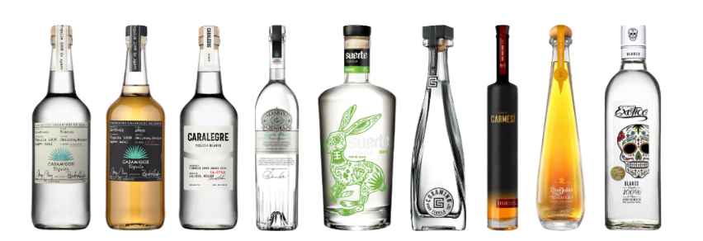
Hypothesis 1
With people becoming more educated about tequila, appreciation for higher-quality, aged varieties has increased.
Hypothesis: Añejo tequilas will be the highest selling brand in higher sales volume stores.
Did you know? The global tequila market is expected to grow at a CAGR of 5.5% by 2028, driven by premiumization and rising consumer awareness.
– Statista, Market Research Future, or IBISWorld
Notes:
Joanna
From grand view research
Ah-nyeh-ho

Slide 20
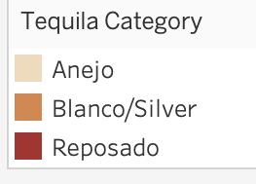
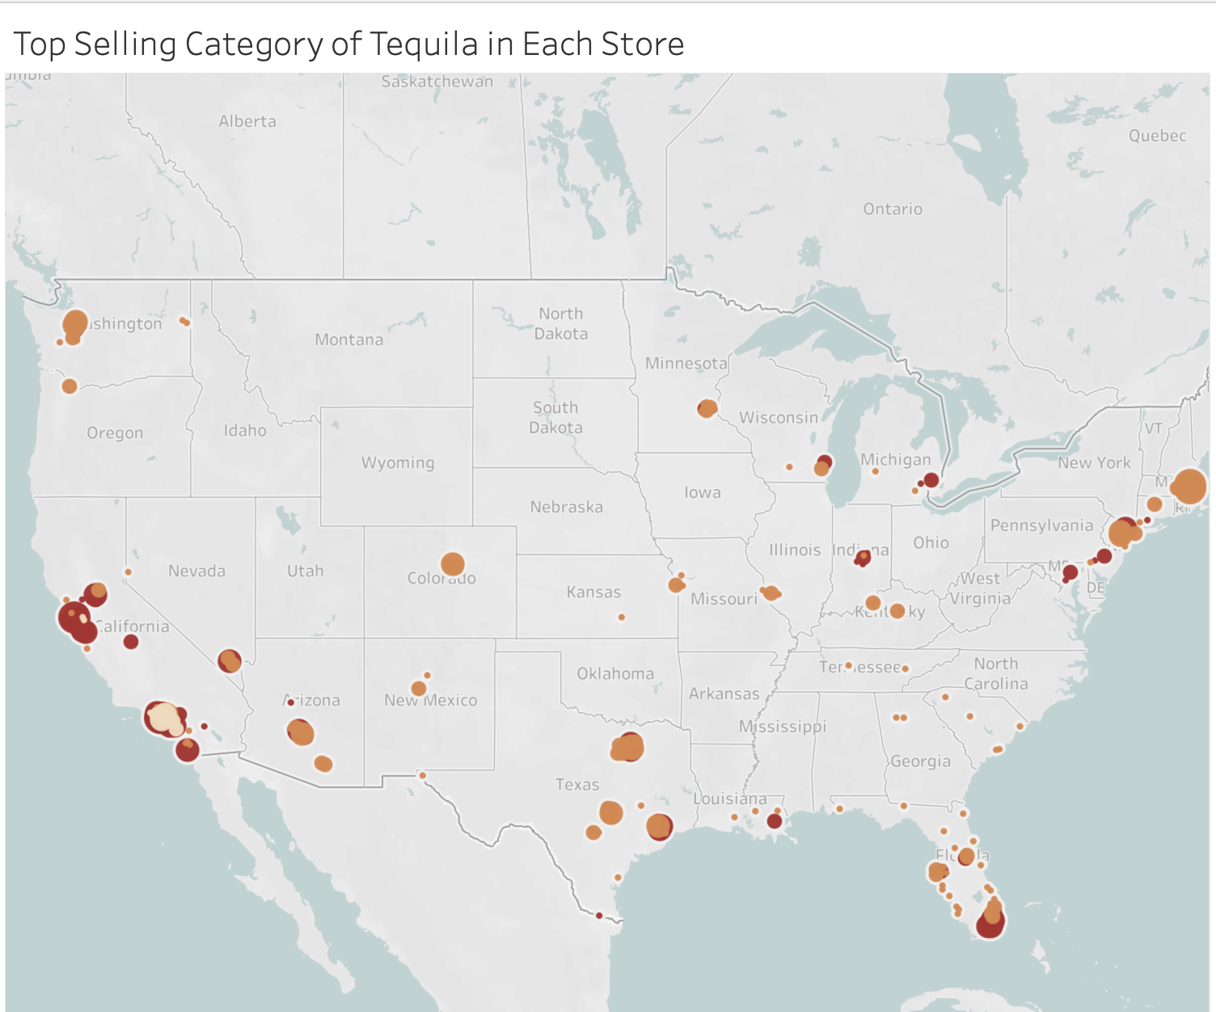
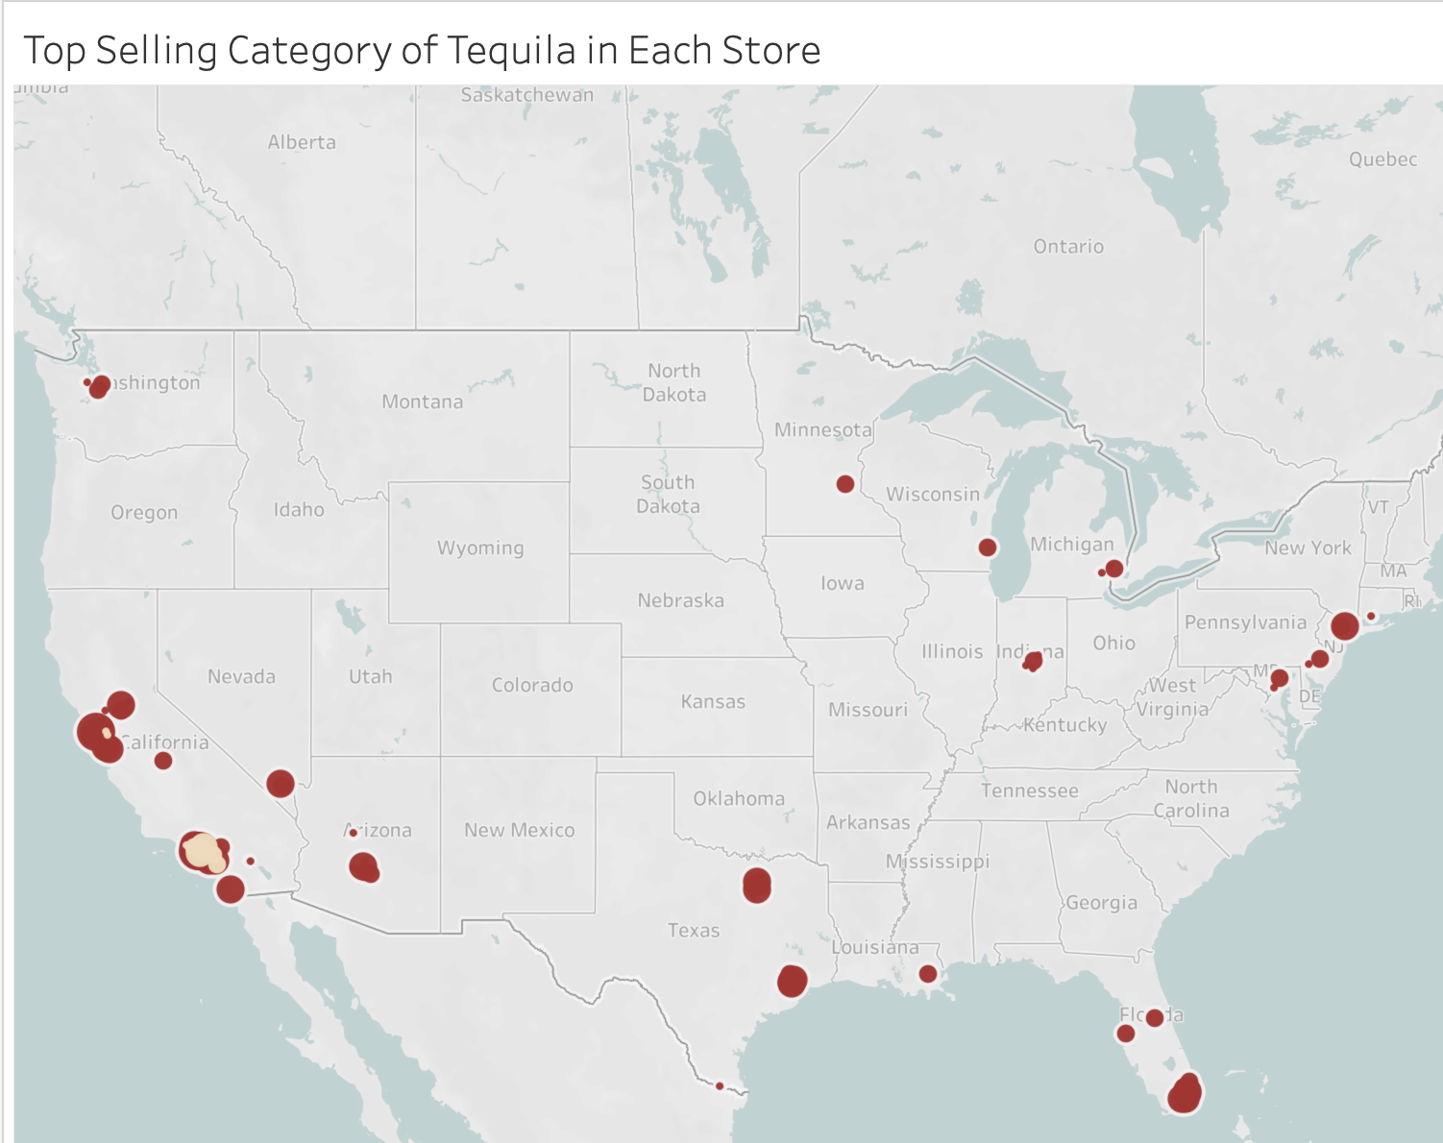
Preliminary Findings (EDA)
Blanco/Silver leads nationally whereas Reposado dominates in one store in an area surrounded by many stores.
Filter out blanco/silver
Notes:
Joanna
5. Preliminary findings, EDA, if any
Top-Selling Tequila Categories by Store: Across the U.S., the top-selling tequila categories vary regionally, with significant concentrations of sales in specific areas. Anejo, Blanco/Silver, & Reposado categories have distinct popularity patterns in different regions.
Top 3 Selling Tequila Brands in Top 10 States: The top three tequila brands by sales volume dominate in key states like California, Florida, & Texas. These brands show a strong presence & high sales, especially in California, indicating brand popularity & consumer preference across these states.

Slide 21
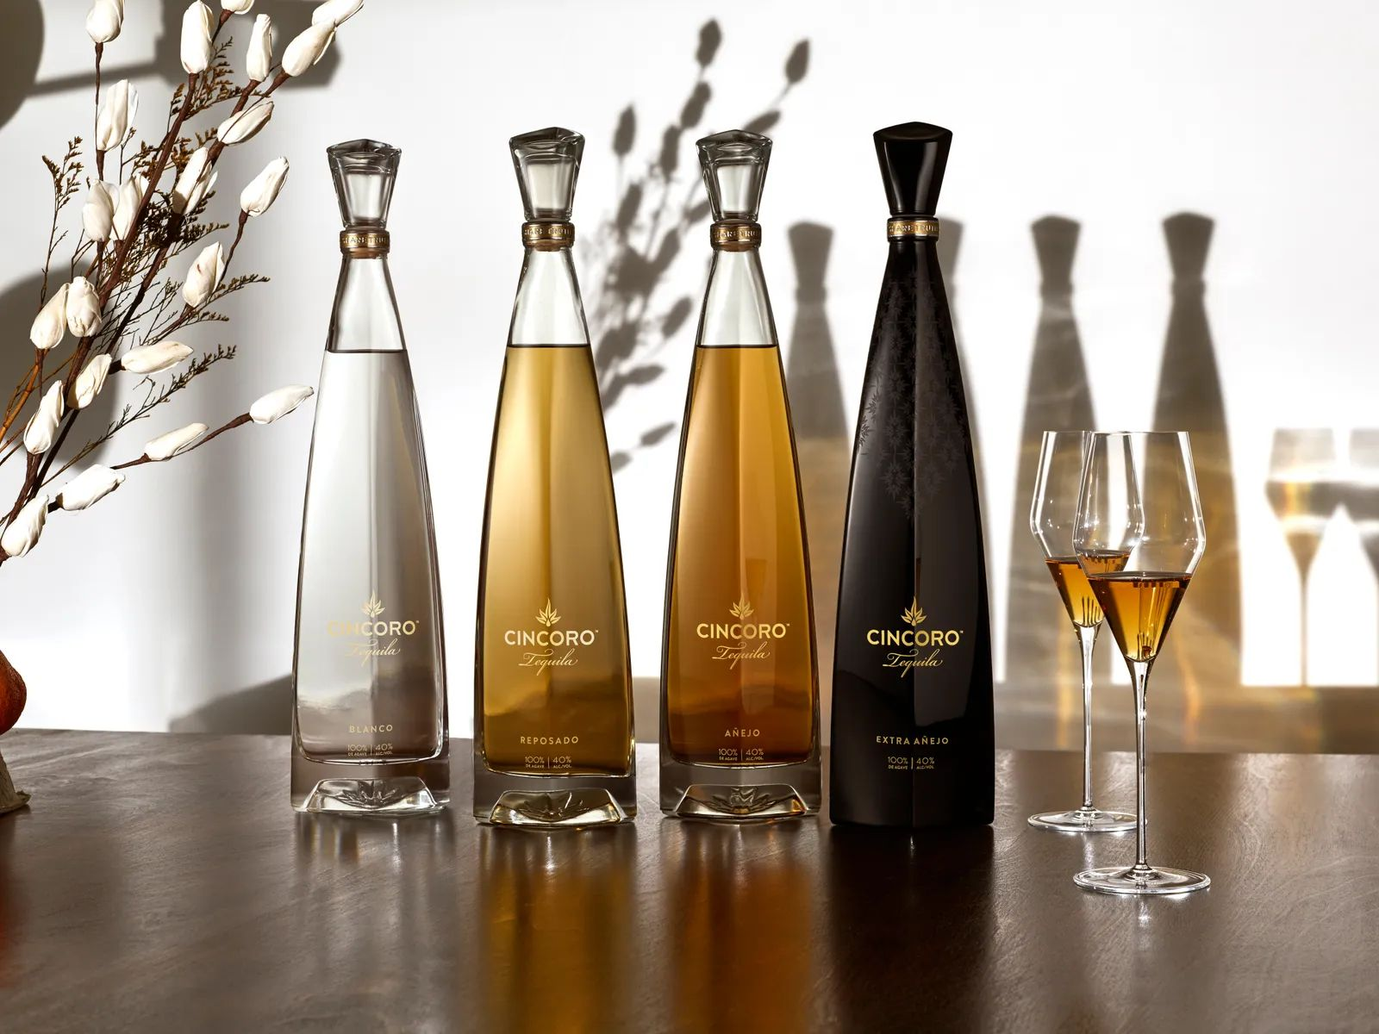
Hypothesis 2
Añejo is the most premium tequila category with it needing the longest aging process while blanco/silver tequila category being the cheapest tequila category with shortest aging time.
Notes:
Joanna

Slide 22
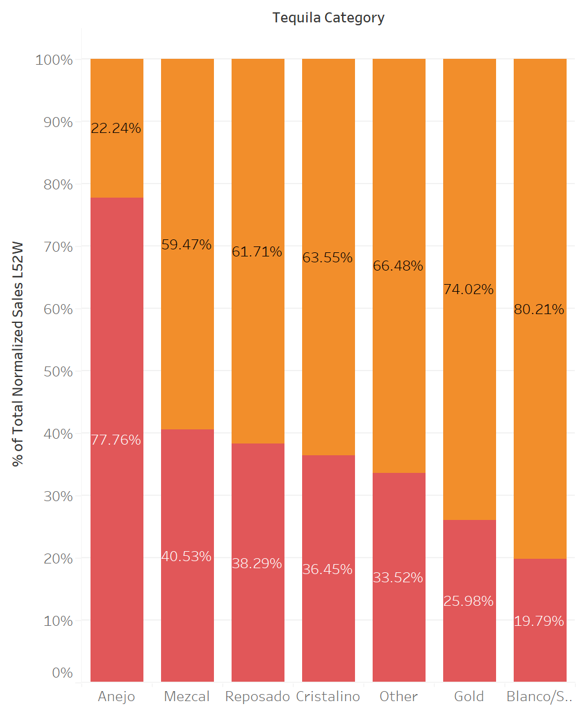
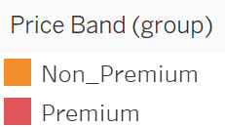
Tequila Category Role
Over 75% of total Añejo tequila sales is premium, with other tequila categories comprised of more non-premium sales, especially for blanco/silver tequila, with around 80% of total sales is non-premium.
Añejo tequila: perceived as a luxury product
Blanco/Silver tequilas: more accessible & often chosen for their affordability or versatility in cocktails
Notes:
Joanna
2)Premium tequila are a big factor in driving sales/ assortment & are lacking in certain stores? - Joanna
Anejo, only tequila category with more premium sales; Most of Blanco/Silver is non-premium sales
Majority of total wine sales are non-premium
Stores with more premium sales are located in lower california & SE of Florida
Tequila categories of Blanco/Silver & Cristalino tend to have less premium sale as store size get smaller, whereas for Anejo, Gold, Resposado, & Other, there are generally more premium sale in small stores compared to large stores

Slide 23
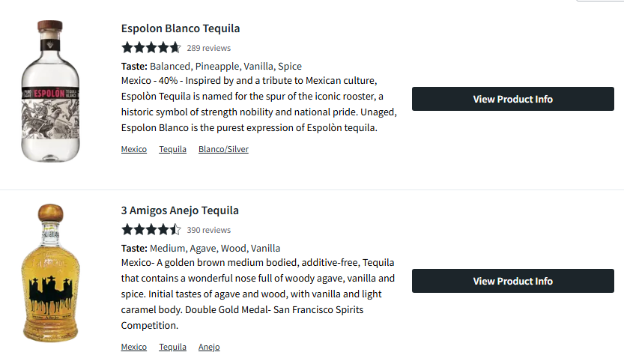
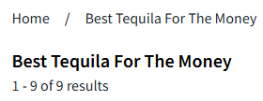
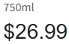
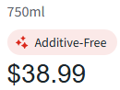
Hypothesis 3
Tequilas priced between $20 & $64, particularly those with lower unit prices per 100ml, drive the majority of sales
Notes:
Val
We wanted to see how the unit price and the price on the shelf drives sales. So our hypothesis here is that

Slide 24
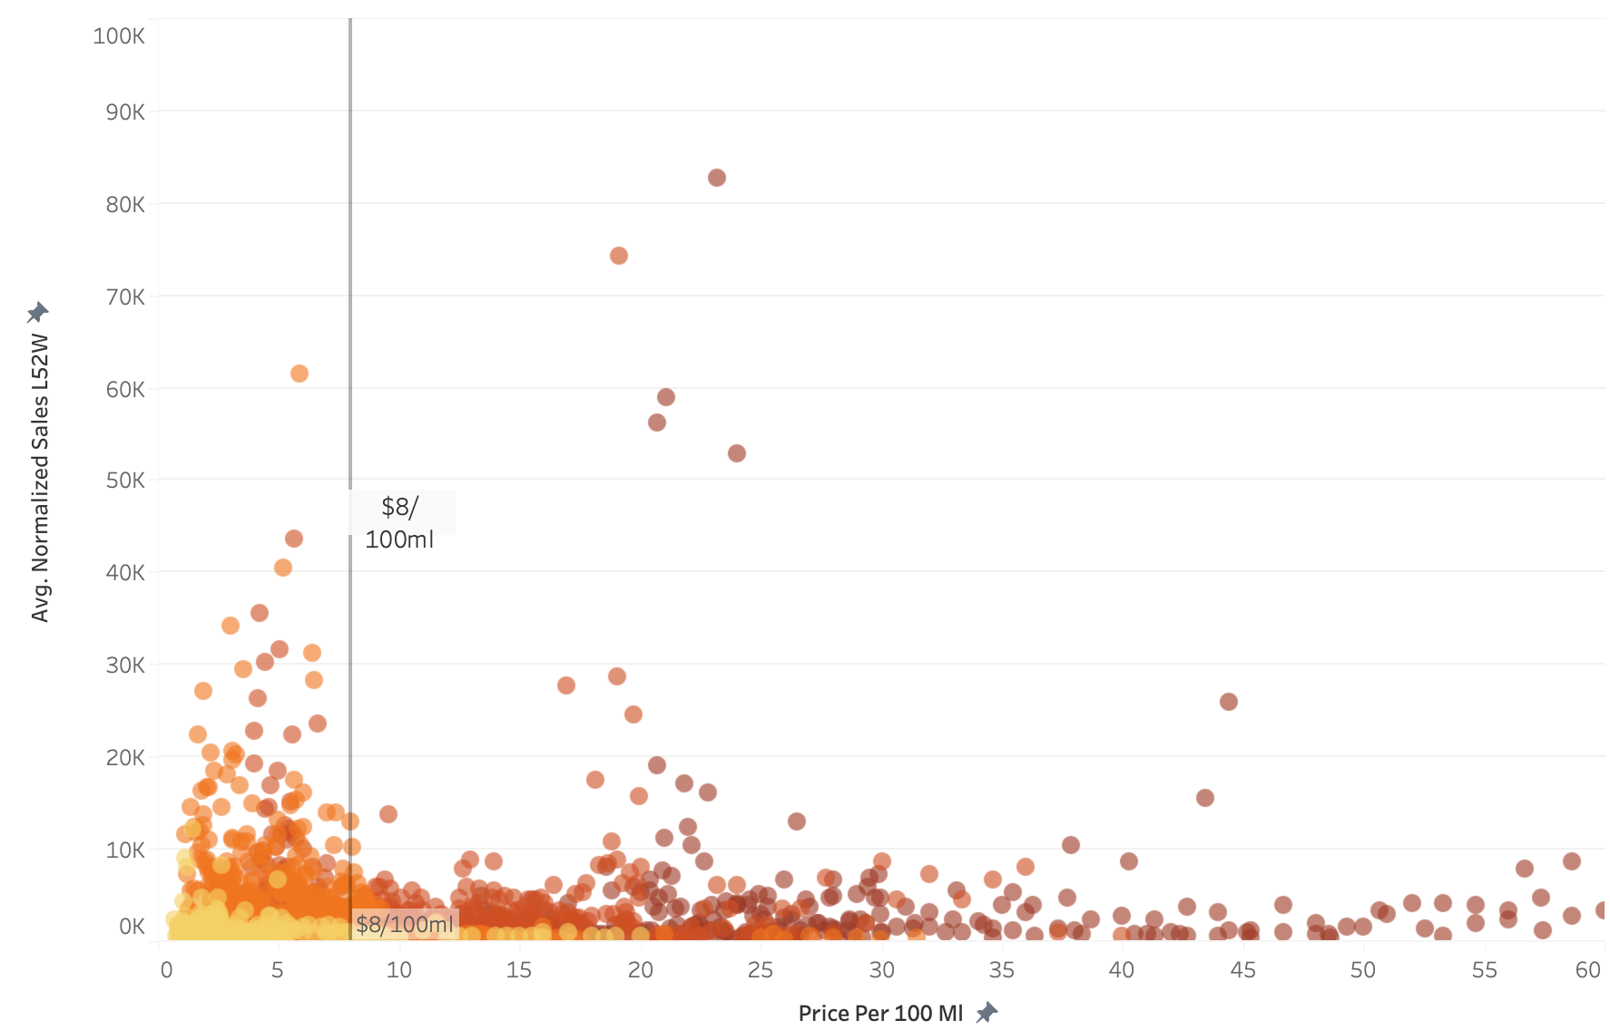
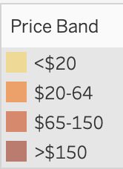
Unit Retail Price Role
Tequilas priced between $20 & $64 accounted for over 50% of total sales, with those having a unit price of less than $8 per 100ml achieving higher average weekly sales over a 52-week period
Prioritize a strong assortment of tequilas priced $20–$64 (50%+ of sales). Focus on <$8 per 100ml options for higher weekly sales & consistent performance.
Offer in-store tastings to justify the higher price points.
Notes:
Val
3) How unit retail price (price per 100ml) play a role - valerie
Those items prices $20-$64 make up over 50% of total wine sales
Looking at the price per 100ML unit price→ those sold for cheaper make up higher sales & those are typically also the ones prices $20-64
Looking into the states with a lower hispanic population we wanted to see if price was a driving factor of which tequila they bought)

Slide 25

Hypothesis 4
Locations with higher hispanic populations drive higher sales.
Notes:
Srishti

Slide 26
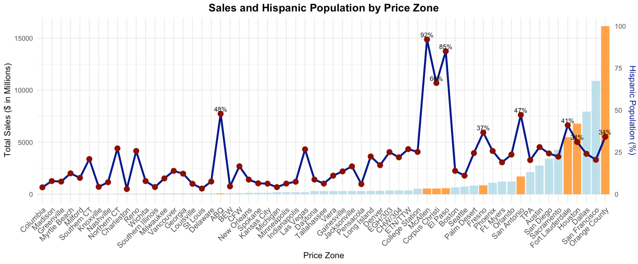
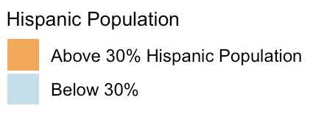
Hispanic Population Role
While some price zones with higher hispanic populations show high sales, the relationship is not consistent. This suggests that factors like local preferences, pricing strategies, or distribution channels might play a more significant role than demographics alone.
Notes:
Looking into the states with a lower hispanic population we wanted to see if price was a driving factor of which tequila they bought)
Srishti

Slide 27
04
Model Description and Metrics
Notes:
Donovan: Modeling Process-GridSearch CrossVal

Slide 28
Modeling Process
Model Selection
Select the best model for the objective.
Parameter Tuning & Model Validation
Find the best parameters for the model, validate the results, & weight the model accordingly.
Test the best model on the test set.
Model Evaluation
Test the best model on the test set.
Notes:
Slide 7

Slide 29

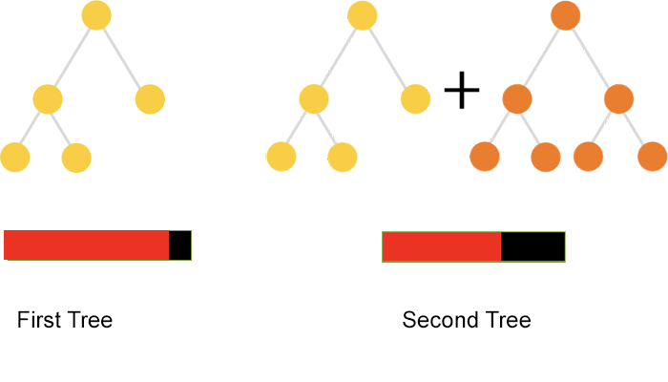
Model Selection
: A gradient boosting algorithm perfect for a large inventory of tequila products.
Boosting Algorithm
Benefits:
Robust model - gradient boosting on decision trees
Efficient algorithm - fast training & predictions
Optimal - handles high-cardinality features natively
Builds iteratively & reduces error over time.
Notes:
Slide 7
5. Preliminary findings, EDA, if any
Top-Selling Tequila Categories by Store: Across the U.S., the top-selling tequila categories vary regionally, with significant concentrations of sales in specific areas. Anejo, Blanco/Silver, & Reposado categories have distinct popularity patterns in different regions.
Top 3 Selling Tequila Brands in Top 10 States: The top three tequila brands by sales volume dominate in key states like California, Florida, & Texas. These brands show a strong presence & high sales, especially in California, indicating brand popularity & consumer preference across these states.

Slide 30
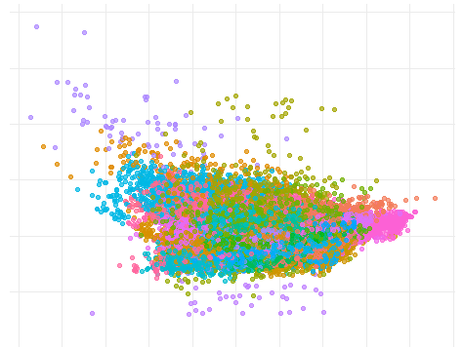
Challenges: Previous Model Attempts
Other models require preprocessing for large categorical variables & lose too much detail.
Item-Store Clusters in 2D
Random Forest Model
Parameters: 500 trees, 13 variables per split
Performance: MAE = 5006.8, RMSE = 4025.1
Much larger error than Catboost.
Regularized Regression
Initial modeling attempted, but one-hot encoding oversimplified the data.
K-means clustering shrunken down using PCA analysis.
Notes:
Slide 7
5. Preliminary findings, EDA, if any
Top-Selling Tequila Categories by Store: Across the U.S., the top-selling tequila categories vary regionally, with significant concentrations of sales in specific areas. Anejo, Blanco/Silver, & Reposado categories have distinct popularity patterns in different regions.
Top 3 Selling Tequila Brands in Top 10 States: The top three tequila brands by sales volume dominate in key states like California, Florida, & Texas. These brands show a strong presence & high sales, especially in California, indicating brand popularity & consumer preference across these states.

Slide 31
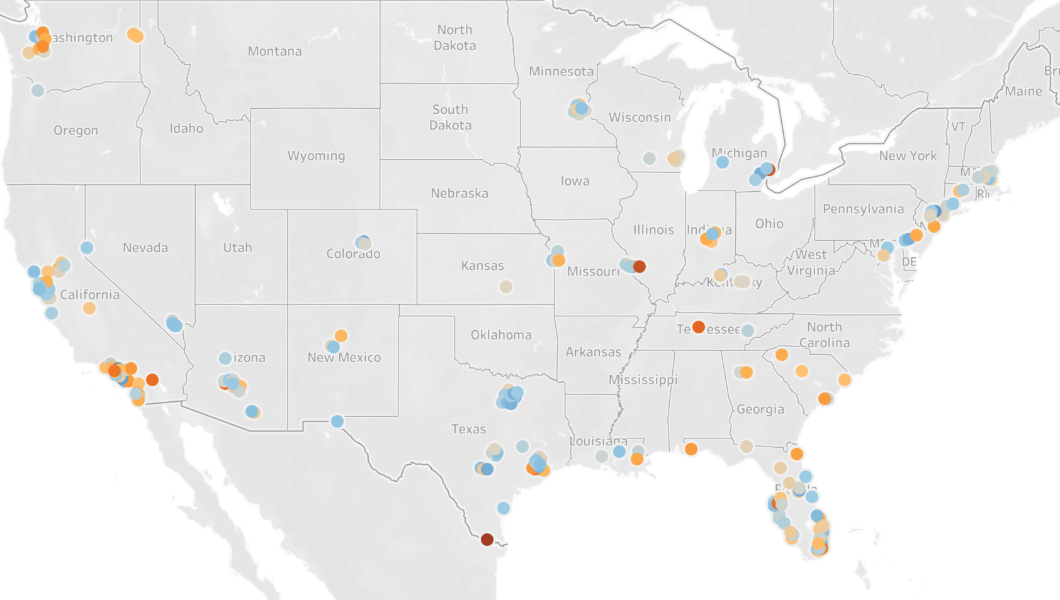
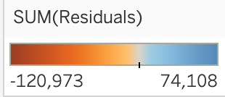
Residual Prediction Analysis
Each store had a mix of model performance: both under & over performing
Created Columns: 1 or 0
Overperforming >Mean(store residual) *2 SD
Underperforming < Mean(store residual) *2 SD
Notes:
valerie

Slide 32
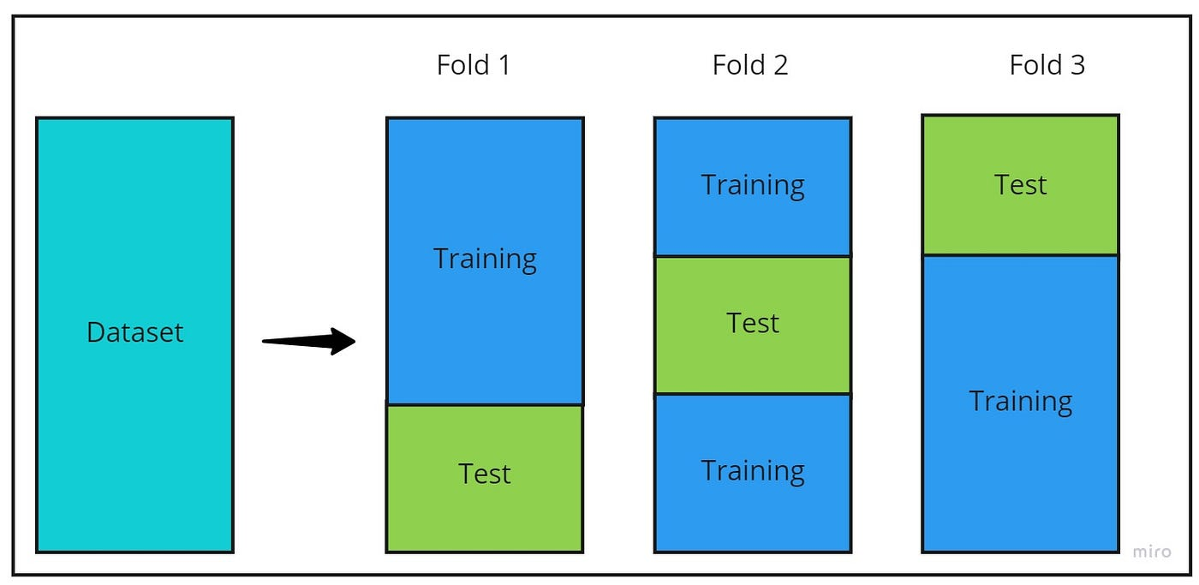
Grid Search Cross-Validation
We combined two validation techniques to tune hyperparameters & reduce bias.
e
Grid Search
K-Fold Cross-Validation
Train 2 models with every combination of parameters to find the best.
Parameters:
Learning Rate - How much the model learns each time.
0.01, 0.03, 0.07, 0.1
Tree Depth - How deep to grow each part of the tree.
4, 6, 8
L2 Leaf Regression - Penalizes overfitting in the model.
1, 3, 10
Iterations - How many trees to build.
500
Train the model k times on all but one fold. Test on the last fold, & average the results.
Train every combination of models 5 times each, giving us 360 models to train.
Notes:
Slide 7
5. Preliminary findings, EDA, if any
Top-Selling Tequila Categories by Store: Across the U.S., the top-selling tequila categories vary regionally, with significant concentrations of sales in specific areas. Anejo, Blanco/Silver, & Reposado categories have distinct popularity patterns in different regions.
Top 3 Selling Tequila Brands in Top 10 States: The top three tequila brands by sales volume dominate in key states like California, Florida, & Texas. These brands show a strong presence & high sales, especially in California, indicating brand popularity & consumer preference across these states.

Slide 33
Model Results
The model is tested on the 20% of data held out for final evaluation.
Final Error: 2913.9
MAE: 1409.43
RMSE: 4417.7
Baseline Error: 7246.99
MAE: 4012.87
RMSE: 10481.12
Notes:
Joanna
Slide 7
5. Preliminary findings, EDA, if any
Top-Selling Tequila Categories by Store: Across the U.S., the top-selling tequila categories vary regionally, with significant concentrations of sales in specific areas. Anejo, Blanco/Silver, & Reposado categories have distinct popularity patterns in different regions.
Top 3 Selling Tequila Brands in Top 10 States: The top three tequila brands by sales volume dominate in key states like California, Florida, & Texas. These brands show a strong presence & high sales, especially in California, indicating brand popularity & consumer preference across these states.

Slide 34
Model Results
This model is the one used to make final predictions.
Combined MAE & RMSE model predictions through averaging.
Captures both "large errors" (RMSE) & "consistent errors" (MAE).
Tested dynamic weighting based on model performance, but a simple average delivered superior results.
Model Specifications
Model Decisions
Best parameters:
Learning Rate: 0.1
Depth: 10
L2 Leaf Reg: 1
Iterations: 500
Weights assigned to each model:
RMSE: 0.5
MAE: 0.5
No data transformations other than setting negative predictions to 0.
The final model is an ensemble model: Prediction = 0.5*RMSE Model + 0.5*MAE Model
Notes:
Srishti
Slide 7
5. Preliminary findings, EDA, if any
Top-Selling Tequila Categories by Store: Across the U.S., the top-selling tequila categories vary regionally, with significant concentrations of sales in specific areas. Anejo, Blanco/Silver, & Reposado categories have distinct popularity patterns in different regions.
Top 3 Selling Tequila Brands in Top 10 States: The top three tequila brands by sales volume dominate in key states like California, Florida, & Texas. These brands show a strong presence & high sales, especially in California, indicating brand popularity & consumer preference across these states.

Slide 35
05
Insights and Recommendations
Notes:
Model insights

Slide 36
Important Features of Final Model
01
Item Code
Sales
External data (sales in surrounding stores)
Expected Features that Performed Well
02
African American population percentage
Volatility of price of the same tequila item code
Category of tequila
Tequila over 65
Unexpected impactful Categorical Features
03
Hispanic population percentage
Celebrity owned tequila (1 or 0)
Google Search Score by state
Expected High-Performing Features That Underperformed
Notes:
Joanna

Slide 37
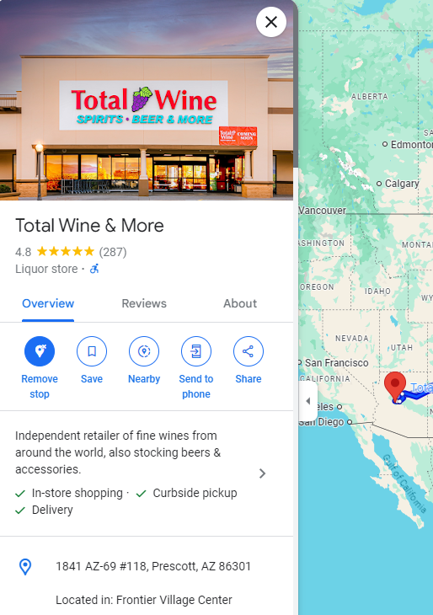
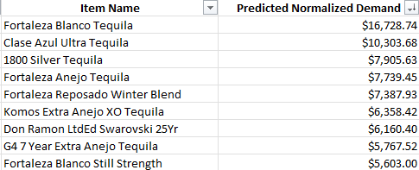
Store-Specific Stocking Recommendations
Store 1012
We recommend stocking these tequilas in this store.
Only 7 tequilas sold well before—these should double it!
Notes:
Joanna

Slide 38
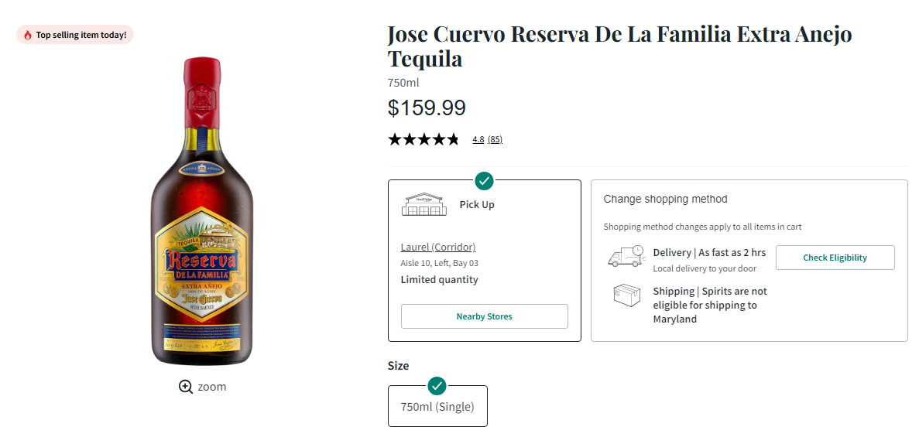
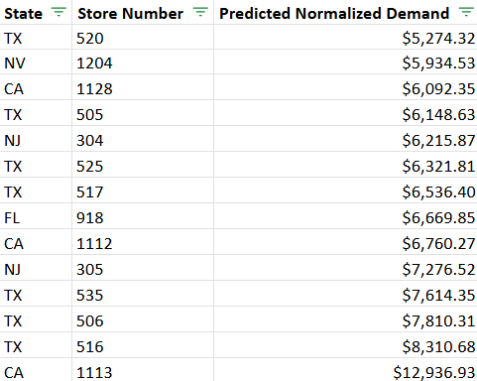
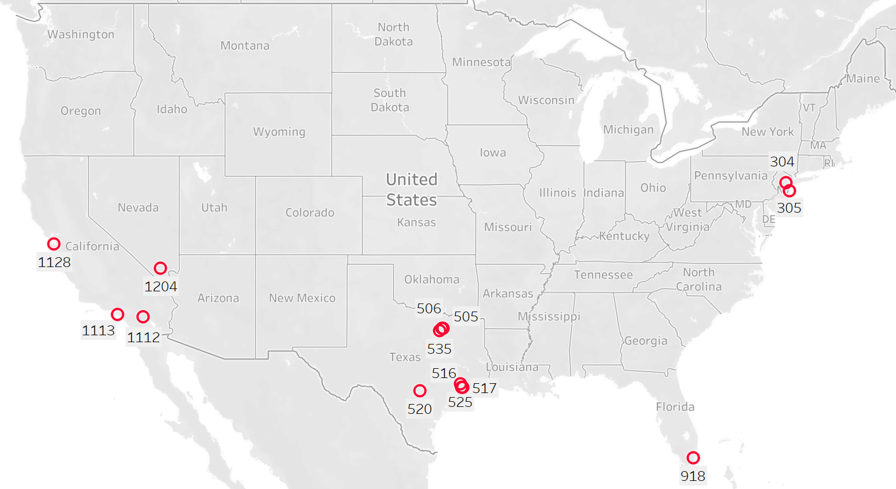
Item-Specific Stocking Recommendations
item code: 9955750
We recommend stocking this tequila in these stores.
Notes:
Val- justify why we chose this tequila. Justification - The average sales, are right around the $5,000 dollar cutoff and would give some nuance to a medium popularity tequila, and also it is extra anejo/premium tequila.
This tequila had the highest normalized sales in 2 stores in the price zone of orange county
Store 1113 is in orange county as well and also had a tier ranking of 4 for tequila over 65

Slide 39
Conclusion
A store’s premium tequila tier ranking is a key indicator of the item in that store’s sales forecast.
Categorizing tequila helped accurately predict sales, highlighting the raised awareness of flavor profile.
CatBoost model was the most efficient model for the objective.
Notes:
Val
Remember that surprising growth in tequila sales we mentioned at the start? With the insights from our project, Total Wine can turn that growth into lasting success by aligning its tequila offerings with customer needs and trends As tequila continues to captivate U.S. consumers, Total Wine has the opportunity to lead the way with smarter, data-driven product assortments.

Slide 40
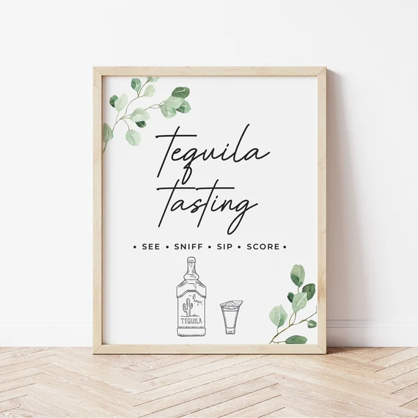
Thank You

Slide 41
Appendix

Slide 42
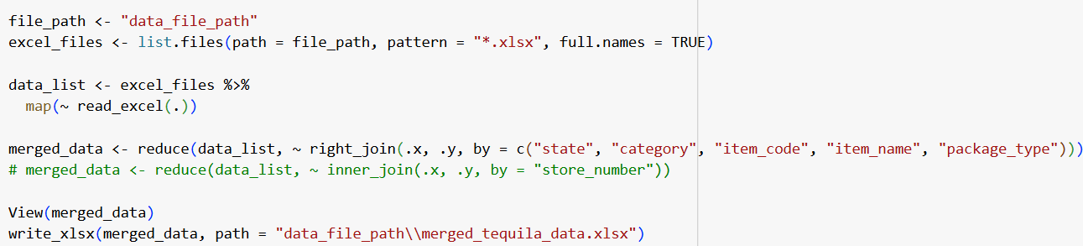
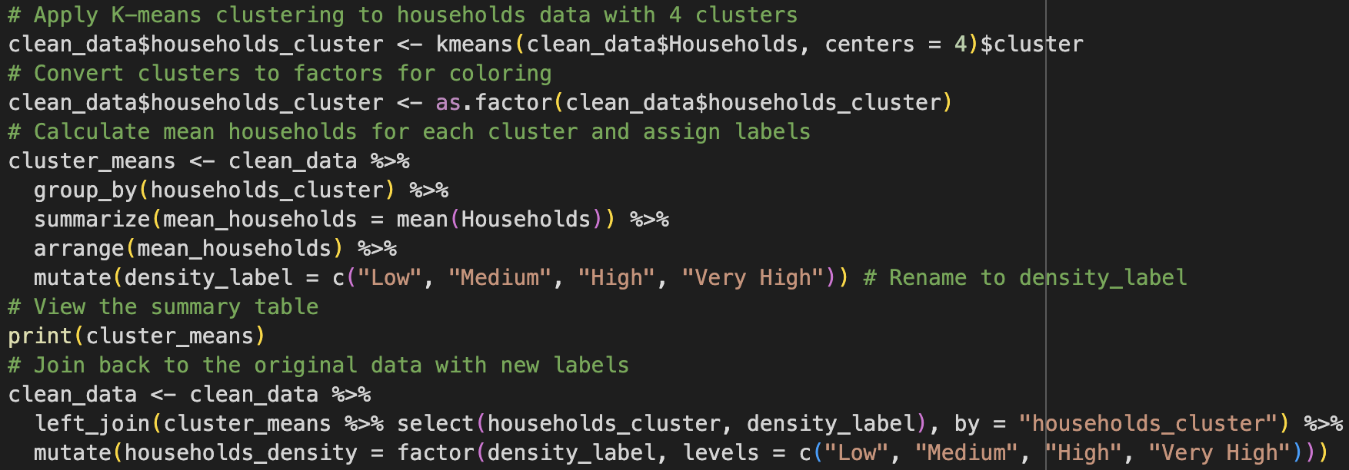
Data Preparation & Cleaning

Slide 43
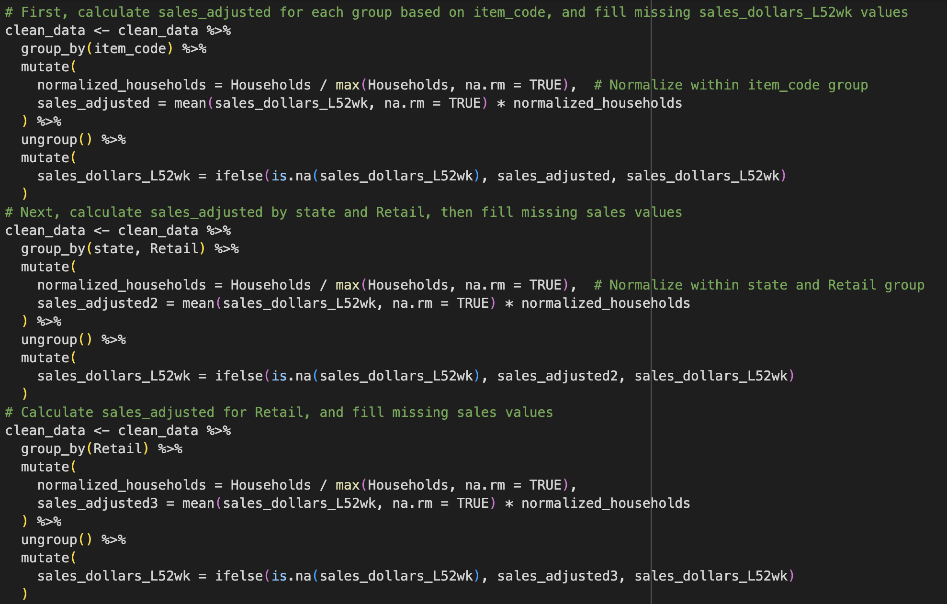
Data Preparation & Cleaning

Slide 44
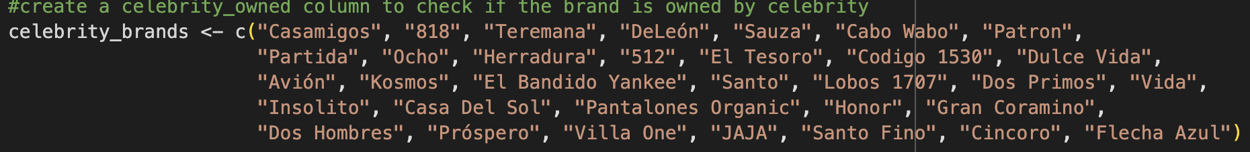
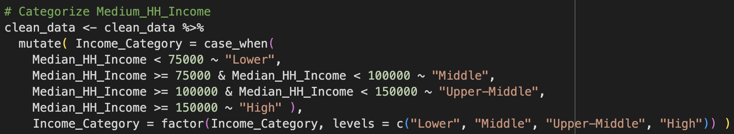
Data Preparation & Cleaning

Slide 45
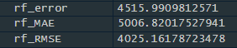
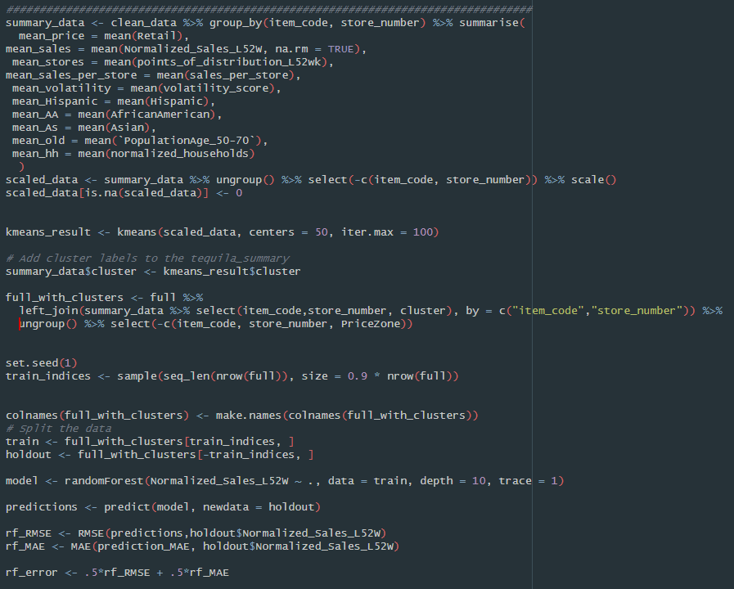
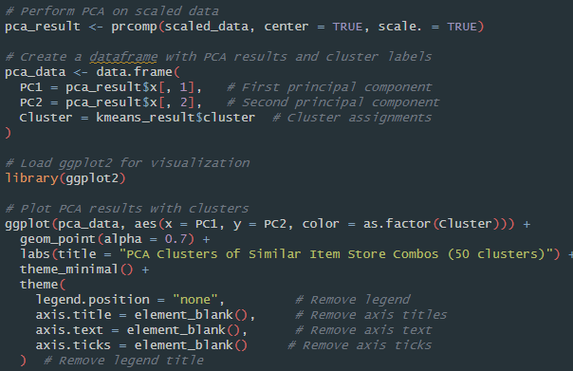
Model clustering that didn't give good results

Slide 46
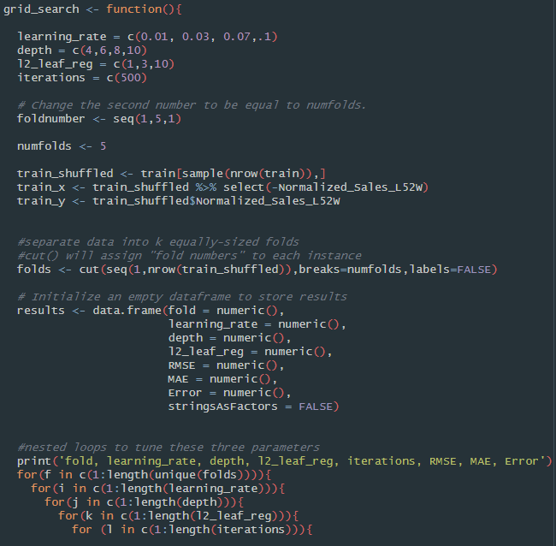
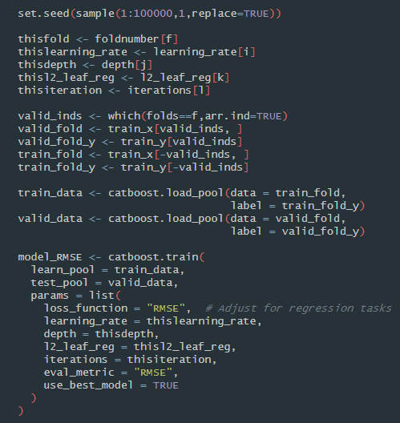
Grid Search

Slide 47
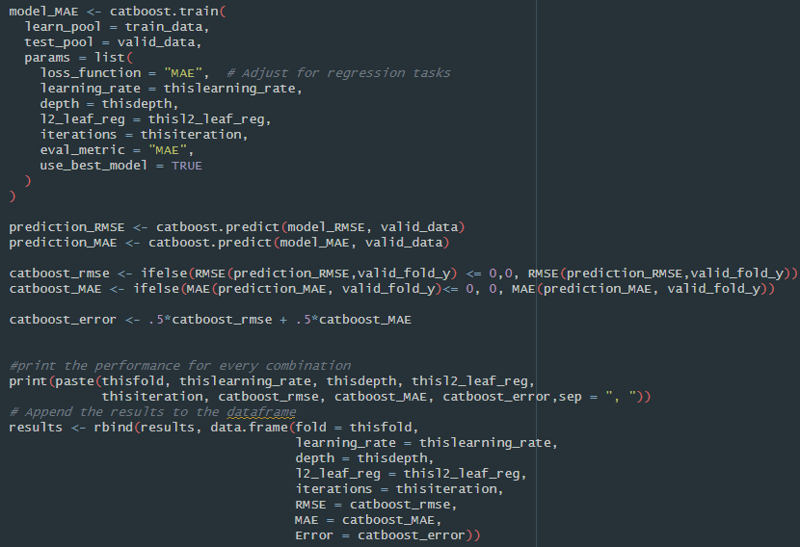
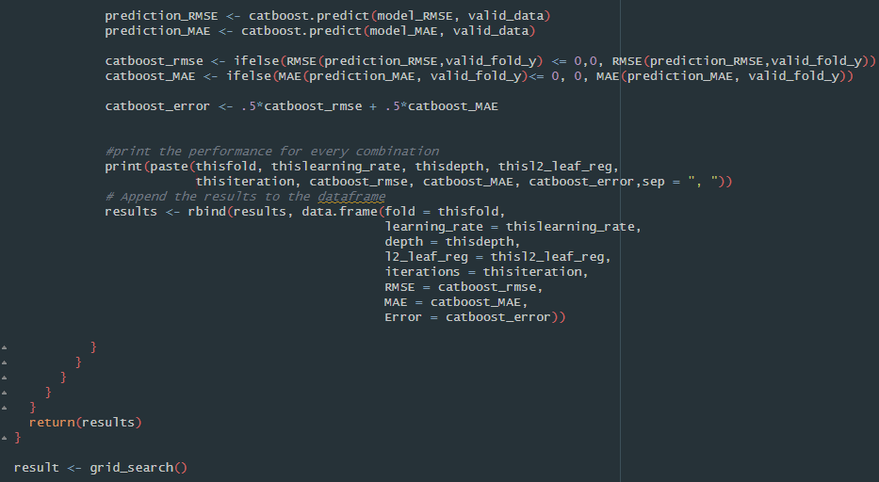
Grid Search (2)

Slide 48
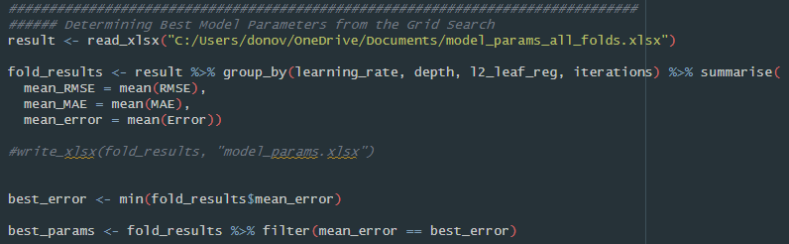
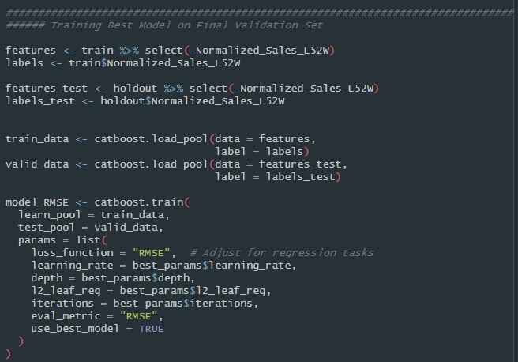
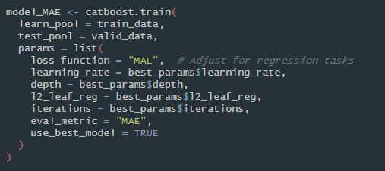
Determining Best Model Parameters

Slide 49
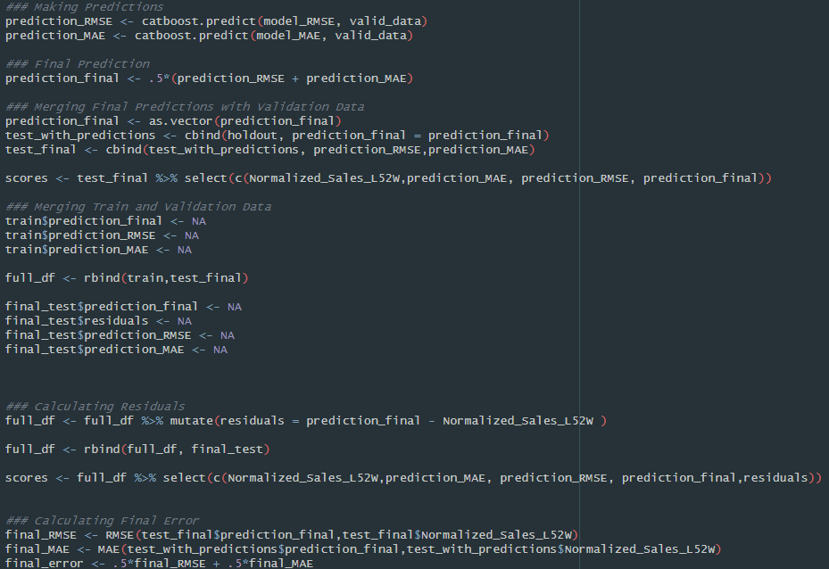
Making Predictions

Slide 50
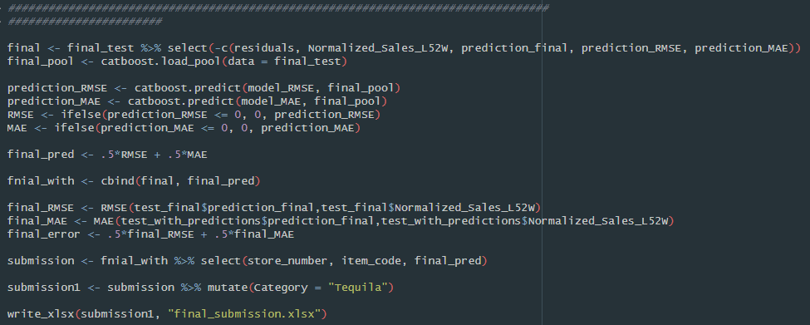
Submission

Slide 51
Source websites
2023 Tequila/Mezcal in the U.S. Fact Sheet NEW1
https://www.grandviewresearch.com/industry-analysis/tequila-market-report
https://www.thedrinksbusiness.com/2020/01/12-celebrities-with-their-own-tequila-brands/

